Slide 1


Introduction to Machine Learning
DBDA.X408.(33)
Instructor:
Bill Chen
UCSC Silicon Valley Extension
E: xch375@ucsc.edu

Slide 2
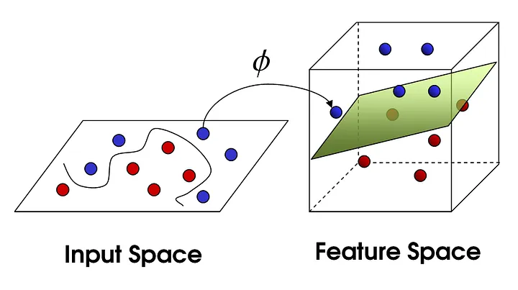
Week 7
Neural Network.
Backprop.
SVM Kernels.

Slide 3
Neural Network

Slide 4
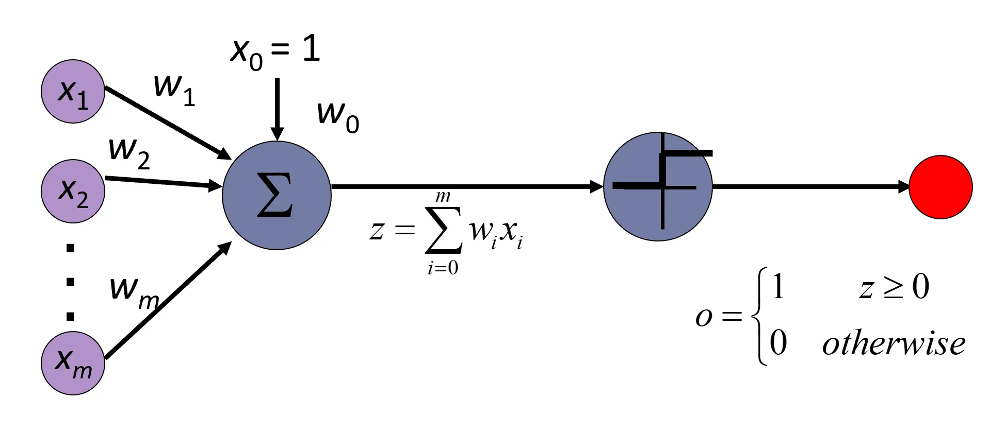
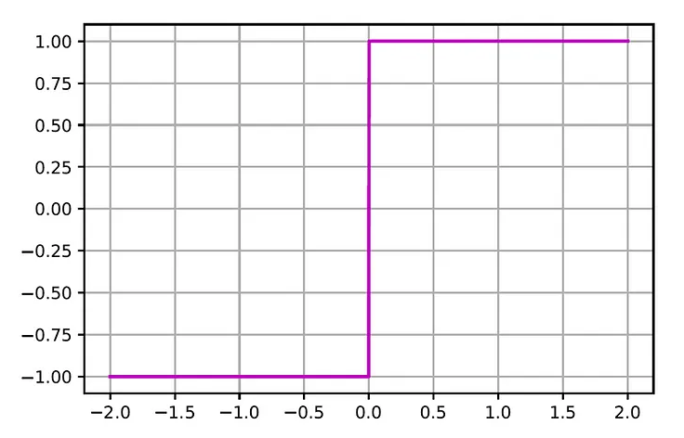
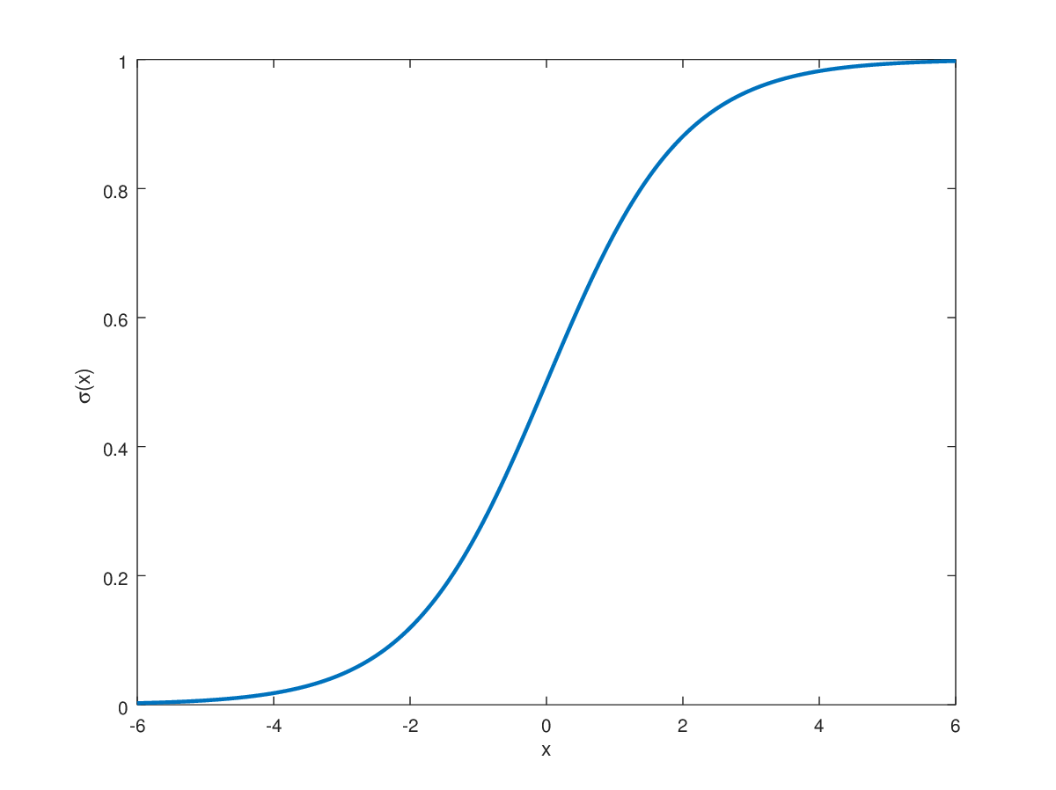
Perceptron Model
Each input neuron xᵢ is connected to the perceptron via a link whose strength is represented by a weight wᵢ. Inputs with higher weights have a larger influence on the perceptron output.
More generally, the perceptron applies an activation function f(z) on the net input that generates its output.
Input
Output
The sign function is a function whose value is -1 for negative inputs and 1 for non-negative inputs. We can also use sigmoid function.

Slide 5
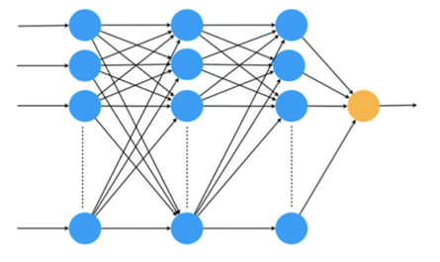
Neural Model: Stack Neurons Together by Layers
x₁
x₂
x₃
…
x_{n}

Slide 6
Neural Model: Stack Neurons Together by Layers
x₁
y₁
x₂
y
x₃
y₃
…
…
x_{n}
y_{n}
Inputs
Outputs

Slide 7
Neural Model: Stack Neurons Together by Layers
x₁
y₁
x₂
y
x₃
y₃
…
…
x_{n}
y_{n}
Inputs
Outputs

Slide 8
Neural Model: Stack Neurons Together by Layers
x₁
x₂
x₃
…
x_{n}
Inputs
Outputs

Slide 9
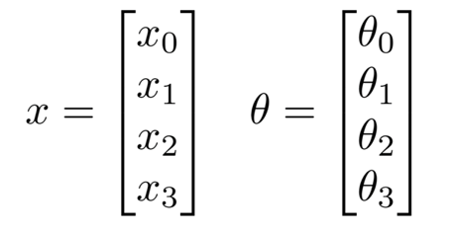
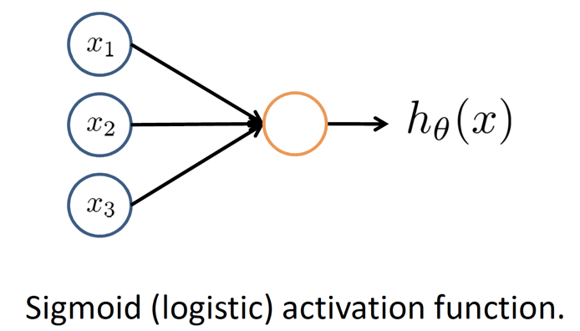
Neuron Model:

Slide 10
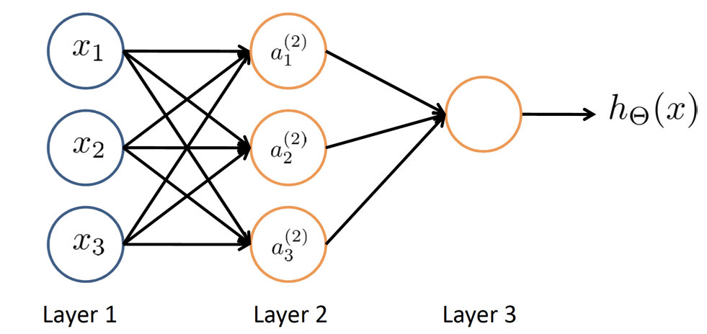
Neural Network

Slide 11
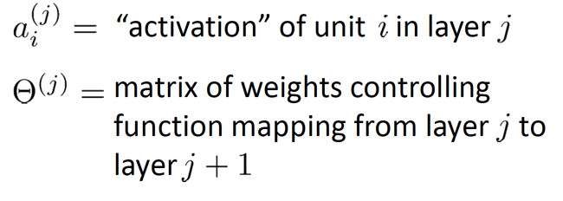
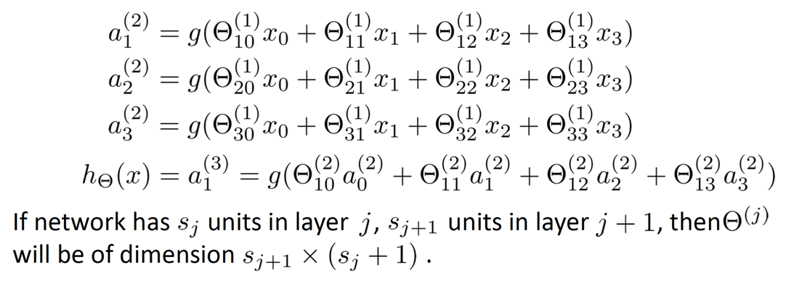
Neural Network

Slide 12
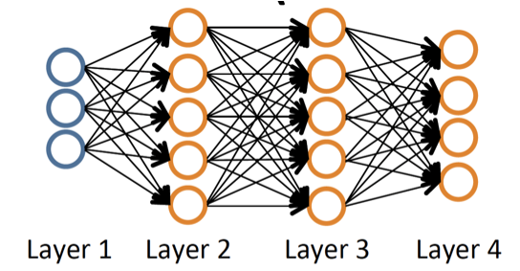
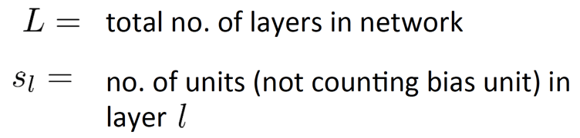
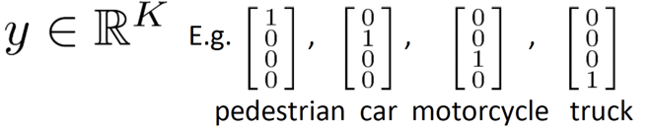
Neural Network - Classification
Binary Classification
y = 0 or 1
1 output unit
Multi-class Classification (k classes)
k output units

Slide 13
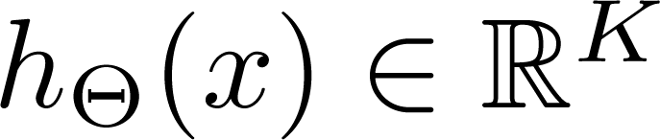
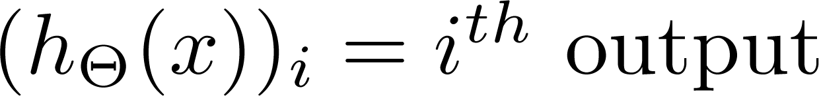
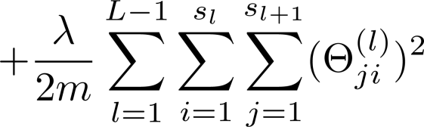
Cost Function
Logistic Regression:
Neural Networks:

Slide 14
Backpropagation

Slide 15
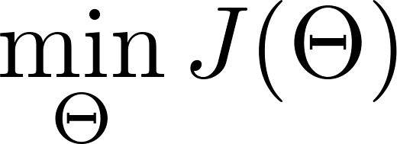
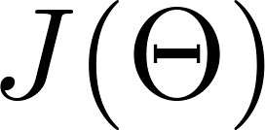
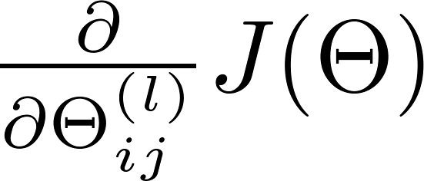
Backpropagation Algorithm
Need code to compute:

Slide 16
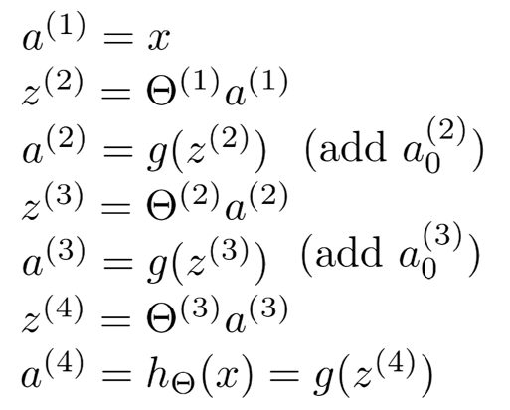
Gradient Computation
Given one training example (x, y):
a⁽²⁾
a⁽³⁾
a⁽⁴⁾
a⁽¹⁾

Slide 17
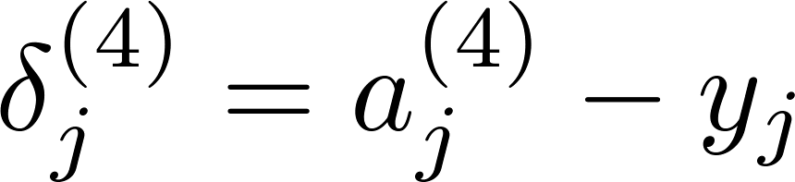
Gradient Computation: Backpropagation Algorithm
Intuition: δ_{j}^{(l)} = “error” of node j in layer l.
For each output unit (layer L = 4)

Slide 18
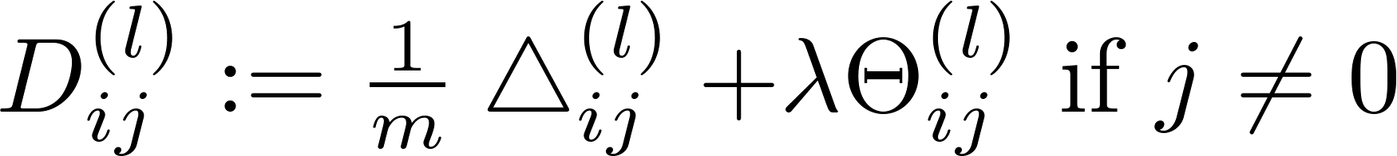
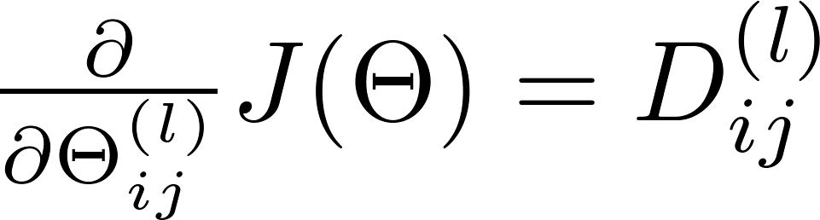
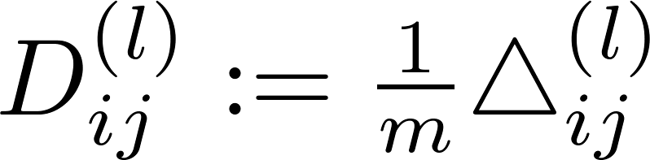
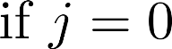
Backpropagation Algorithm
Training set
Set Δ_{ij}^{(l)} = 0 (for all l, i, j)
For i = 1 to m
Set a⁽¹⁾ = x^{(i)}
Perform forward propagation to compute a^{(l)} for l = 2, 3, …, L
Using y^{(i)}, compute δ^{(l)} = a^{(L)} - y^{(i)}
Compute δ^{(l-1)}, δ^{(l-2)}, … δ⁽²⁾
Δ_{ij}^{(l)} := Δ_{ij}^{(l)} + a_{j}^{(l)} δ_{i}^{(l+1)}

Slide 19
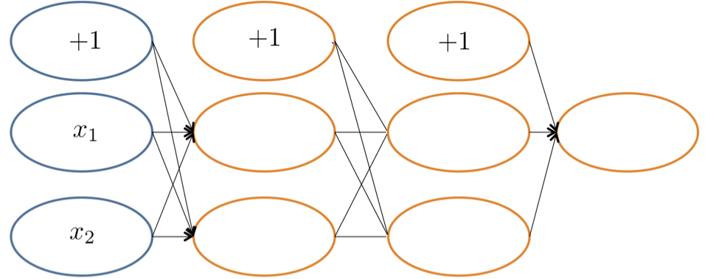
Forward Propagation

Slide 20
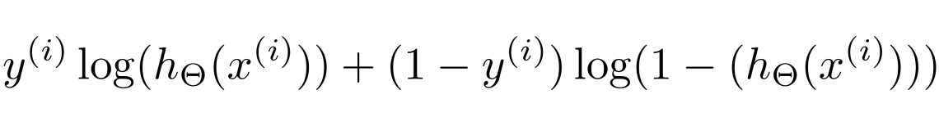
Backpropagation
Focusing on a single example x^{(i)}, y^{(i)}, the case of 1 output unit, and ignoring regularization (λ = 0),
(Think of cost(i) ≈ (h⊝(x^{(i)}) - y^{(i)}))
I.e. how well is the network doing on example i?
cost(i) =

Slide 21
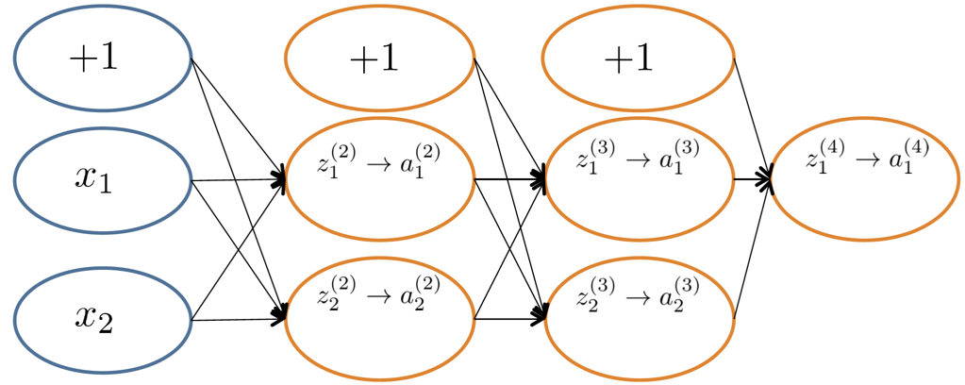
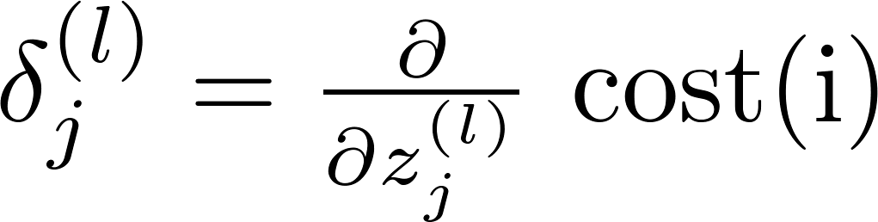
Forward Propagation
δ_{j}^{(l)} = “error” of cost for aj(l) (unit j in layer l).
Formally, (for j >=0), where

Slide 22
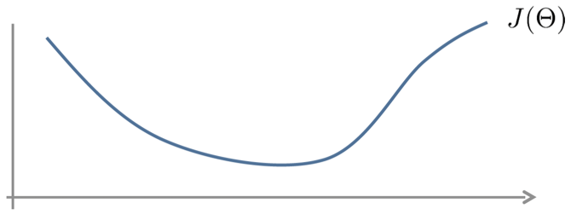
Numerical Estimation of Gradients

Slide 23
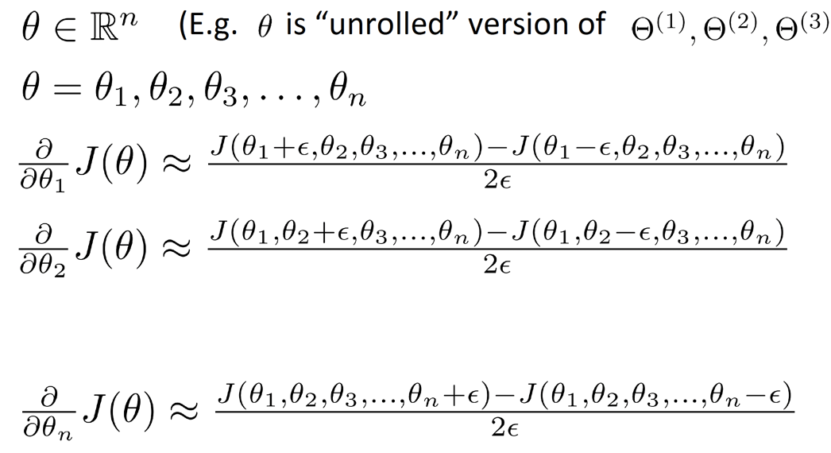

Parameter Vector θ

Slide 24
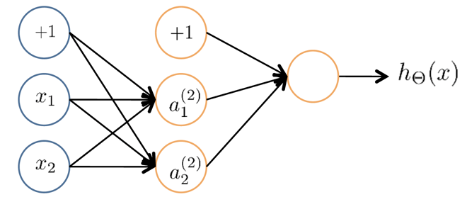
Initial Value of θ
For gradient descent and advanced optimization method, need initial value of θ.
Consider gradient descent, set the initial θ to zeros?
After each update, parameters corresponding to inputs going into each of two hidden units are identical.

Slide 25
Random Initialization: Symmetry Breaking
Initialize each θ_{ij}^{(l)} to a random value in [-є,є] (i.e. -є ≤ θ_{ij}^{(l)} ≤ є)

Slide 26
Put Together
Pick a network architecture (connectivity pattern between neurons)
No. of input units: Dimension of features x^{(i)}.
No. of output units: Number of classes.
Reasonable default: 1 hidden layer, or if >1 hidden layer, have same no. of hidden units in every layer (usually the more the better)

Slide 27
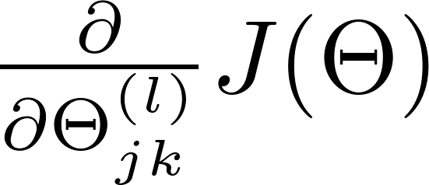
Training a Neural Network
Randomly initialize weights
Implement forward propagation to get h_{θ}(x^{(i)}) for any x^{(i)}.
Implement code to compute cost function J(θ).
Implement backprop to compute partial derivatives
for i = i:m
Perform forward propagation and backpropagation using example (x^{(i)}, y^{(i)})
(Get activations a^{(l)} and delta terms δ^{(l)} for l = 2, …, L).
Using gradient checking to compute computed using backpropagation vs. using numerical estimate of gradient of J(θ).
Using gradient descent or advanced optimization method with backpropagation to try to minimize J(θ) as a function of parameter θ.

Slide 28
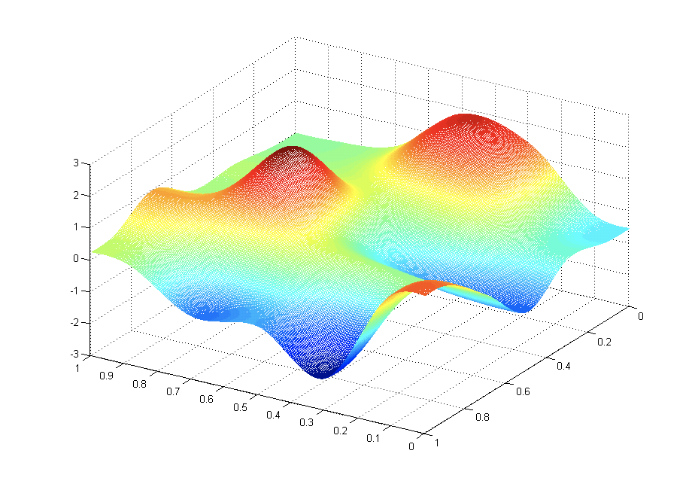
Backpropagation Visualization

Slide 29
SVM Kernel Trick

Slide 30
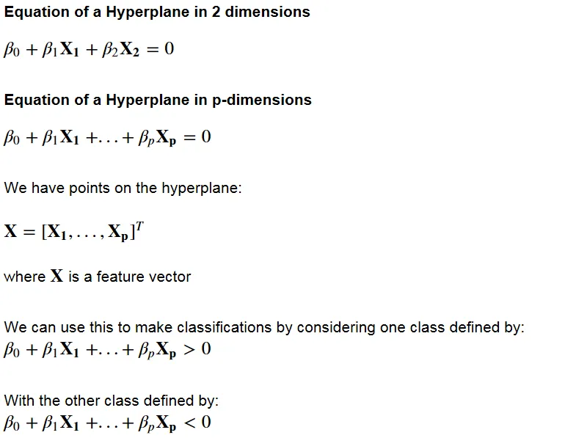
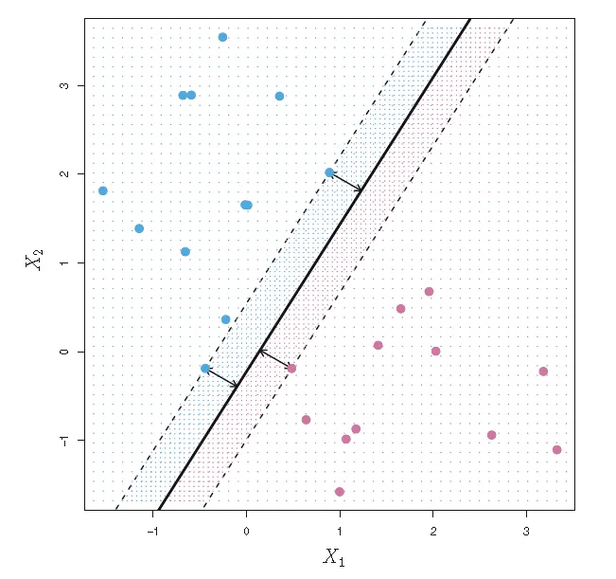
SVM: Review
Support vector classification relies on this notion of linearly separable data. “Soft margin” classification can accommodate some classification errors on the training data, in the case where data is not perfectly linearly separable. However, in practice data is often very far from being linearly separable, and we need to transform the data into a higher dimensional space in order to fit a support vector classifier.
The support vectors are the points on the dashed lines. The distance from the dashed line to the solid line is the margin, represented by the arrows.

Slide 31
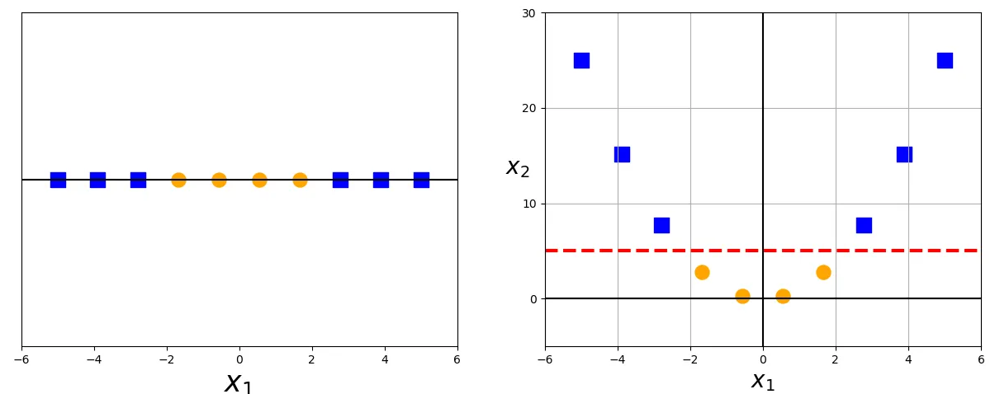
SVM: Non-linear Transformations
In 1-dimension, this data is not linearly separable, but after applying the transformation ϕ(x) = x² and adding this second dimension to our feature space, the classes become linearly separable
Notes:
If the data is not linearly separable in the original, or input, space then we apply transformations to the data, which map the data from the original space into a higher dimensional feature space.
The goal is that after the transformation to the higher dimensional space, the classes are now linearly separable in this higher dimensional feature space. We can then fit a decision boundary to separate the classes and make predictions. The decision boundary will be a hyperplane in this higher dimensional space.

Slide 32
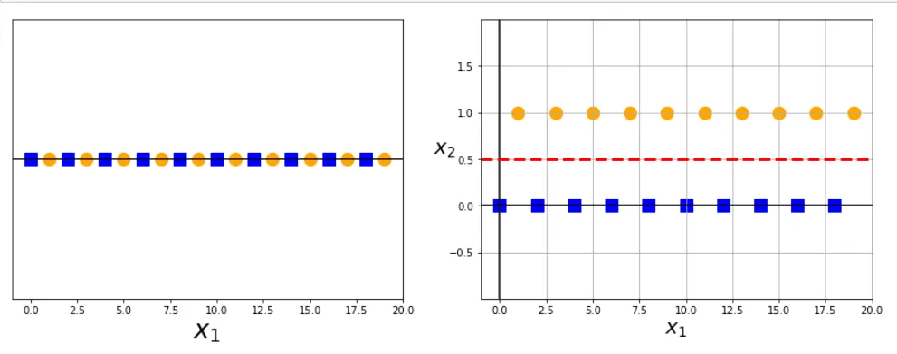
SVM: Non-linear transformations

Slide 33
SVM: Non-linear transformations
ϕ(x) = x mod 2

Slide 34
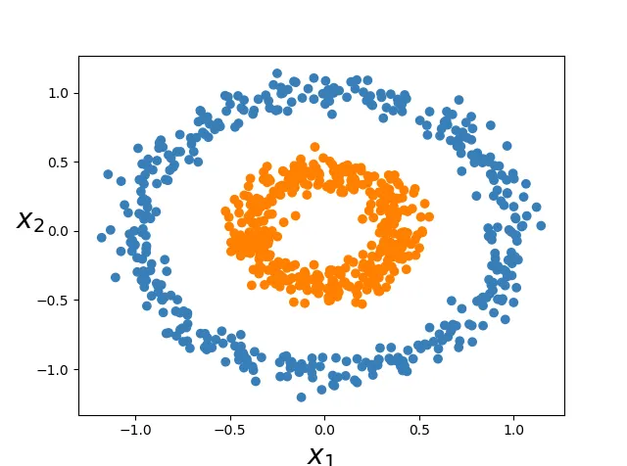
SVM: Non-linear Transformations
Notes:
Linearly separable data in 3-d after applying the 2nd-degree polynomial transformation

Slide 35
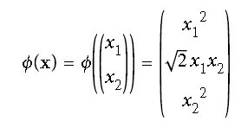
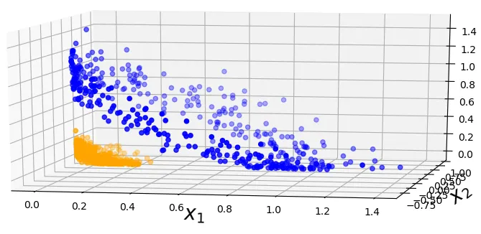
SVM: Non-linear Transformations
Notes:
Linearly separable data in 3-d after applying the 2nd-degree polynomial transformation

Slide 36
The Kernel Trick
It seems that in order to train a support vector classifier and optimize our objective function, we would have to perform operations with the higher dimensional vectors in the transformed feature space. In real applications, there might be many features in the data and applying transformations that involve many polynomial combinations of these features will lead to extremely high and impractical computational costs.
The kernel trick provides a solution to this problem. The “trick” is that kernel methods represent the data only through a set of pairwise similarity comparisons between the original data observations x (with the original coordinates in the lower dimensional space), instead of explicitly applying the transformations ϕ(x) and representing the data by these transformed coordinates in the higher dimensional feature space.

Slide 37
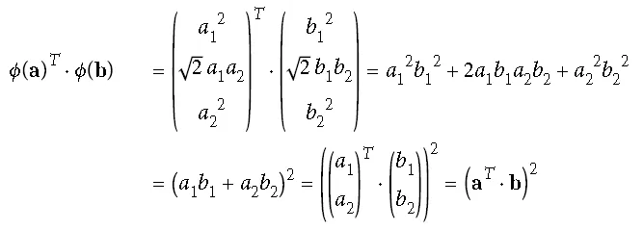
Kernel Definition
A function that takes as its inputs vectors in the original space and returns the dot product of the vectors in the feature space is called kernel function.
More formally, if we have data x, z ∈ X and a map ϕ: X → R^{N} then
k(x, z) = 〈ϕ(x), ϕ(z)〉
is a kernel function.
There are also theorems which guarantee the existence of such kernel functions under certain conditions.
Notes:
Our kernel function accepts inputs in the original lower dimensional space and returns the dot product of the transformed vectors in the higher dimensional space. There are also theorems which guarantee the existence of such kernel functions under certain conditions.
For example, the kernel trick for the 2nd-degree polynomial is illustrated below, and we visualized this transformation in 3-d in a previous figure. The transformed vectors have coordinates that are functions of the two components x1 and x2. so the dot product will only involve components x1 and x2 as well. The kernel function will also take inputs x1, x2 and return a real number. The dot product always returns a real number too.
The ultimate benefit of the kernel trick is that the objective function we are optimizing to fit the higher dimensional decision boundary only includes the dot product of the transformed feature vectors. Therefore, we can just substitute these dot product terms with the kernel function, and we don’t even use ϕ(x).

Slide 38
Quizzes and Assignments

